Slide 1
Epileptic Dogs: Advanced Seizure Prediction
Taylor Neely & Jack Terwilliger

Slide 2
"It’s the variability that really makes it so stressful. You never know when it is going to be chaos again and you’ll have one. Just because this morning is terrific doesn’t mean tonight is going to be terrific, either behavior-wise, medication-wise, or any otherwise. So it is the unpredictability of it that is really nerve-racking to live with."
-Murray Coping with the uncertainty of uncontrolled epilepsy, Seizure 2 (1993) 167–178

Slide 3
Seizure Prediction can improve quality of life for patients with epilepsy
Epilepsy is a neural disorder characterized by spontaneous seizures
Severity varies between patients
Treatment is ineffective for ~30% of patients
Affects 1% of global population
Unforeseen seizures can put epileptics at risk during everyday activities
Prediction allows for smarter decisions and reduced stress

Slide 4
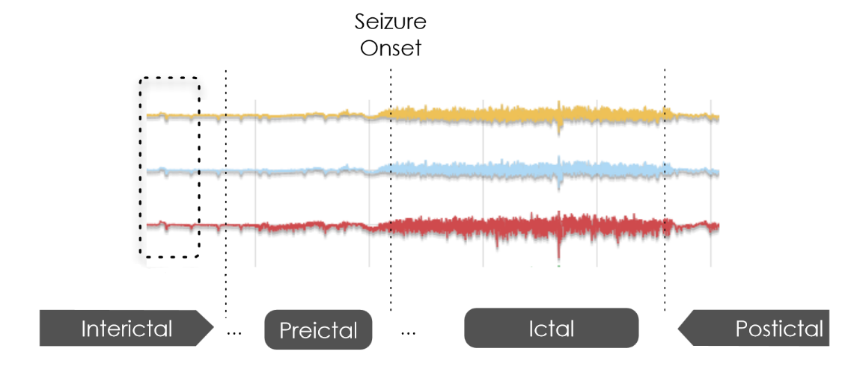

Slide 5
Available Dataset
5 dogs, 2 humans
Each dog has ~500 training examples (470 interictal, 30 preictal)
~120 test examples
Each example is an EEG segment over 10 minutes at 400Hz
240,000 data points across 15-20 channels
Interictal segments for dogs are taken from +1 week before or after seizure
Preictal segments can be from 1:05 to 0:05 before seizure onset

Slide 6
“there is not any system usable by patients allowing them to predict a coming seizure and to take action to preserve his (her) safety and privacy, improving substantially his (her) social integration. This is probably because most of the researchers look for a general method and algorithm that would work for every patient. And although several authors propose methods to which they claim a high performance, the considered performance criteria is only partial, neglecting other parts of the problem that prevent them to be used in a clinical environment.“
-V. K̊urkov ́a et al. (Eds.): ICANN 2008, Part II, LNCS 5164, pp. 479–487, 2008.

Slide 7
Per-subject approach
Reduce each segment into a scalar features using univariate analysis
Input scalar features into neural network and train
Use trained weights in neural network to classify test data

Slide 8
Feature Generation (Current)
Spectral Edge Frequency
Uses FFT to generate power spectrum
Finds frequency at which 90% of spectral power lies below
Signal Power
Uses FFT to generate power spectrum
Finds max power (and frequency of max power) for each brain wave
Theta, delta, alpha, beta, gamma waves

Slide 9
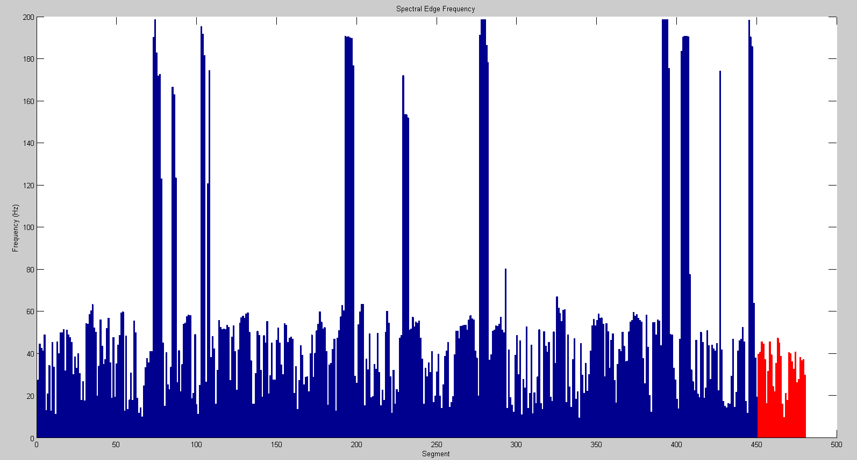
Interictal
Preictal

Slide 10
Feature Generation (Future)
Wavelet Transform (decomposition)
Increments of Accumulated Energy
Effective Correlation Dimension
Spectral Entropy

Slide 11
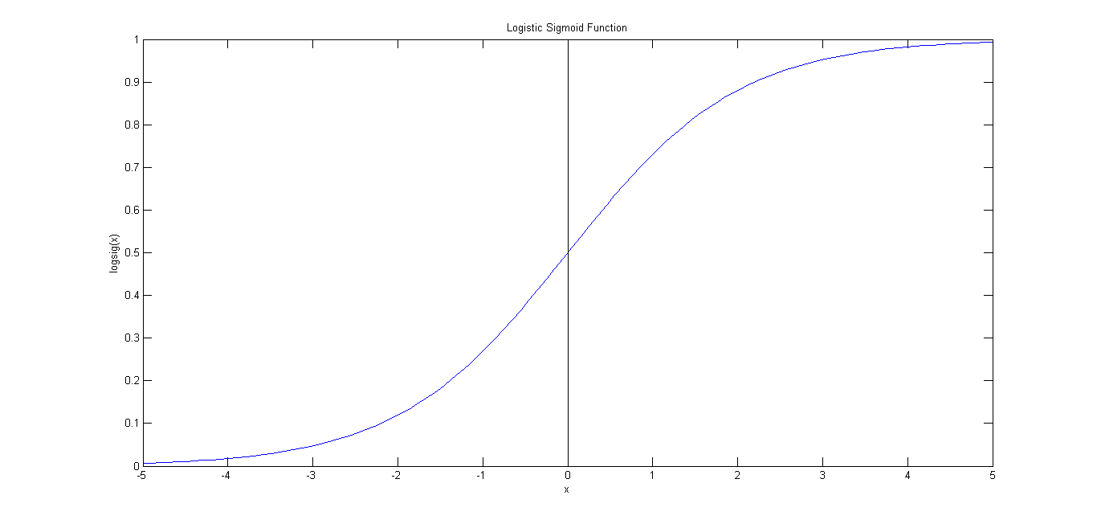
Neural Network
Feedforward, Dense, Neural Network
Backpropagation
Logistic Sigmoid Activation Function
Positive Tests on XOR function

Slide 12
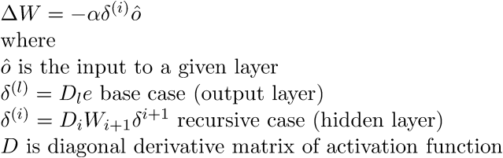
Neural Network

Slide 13
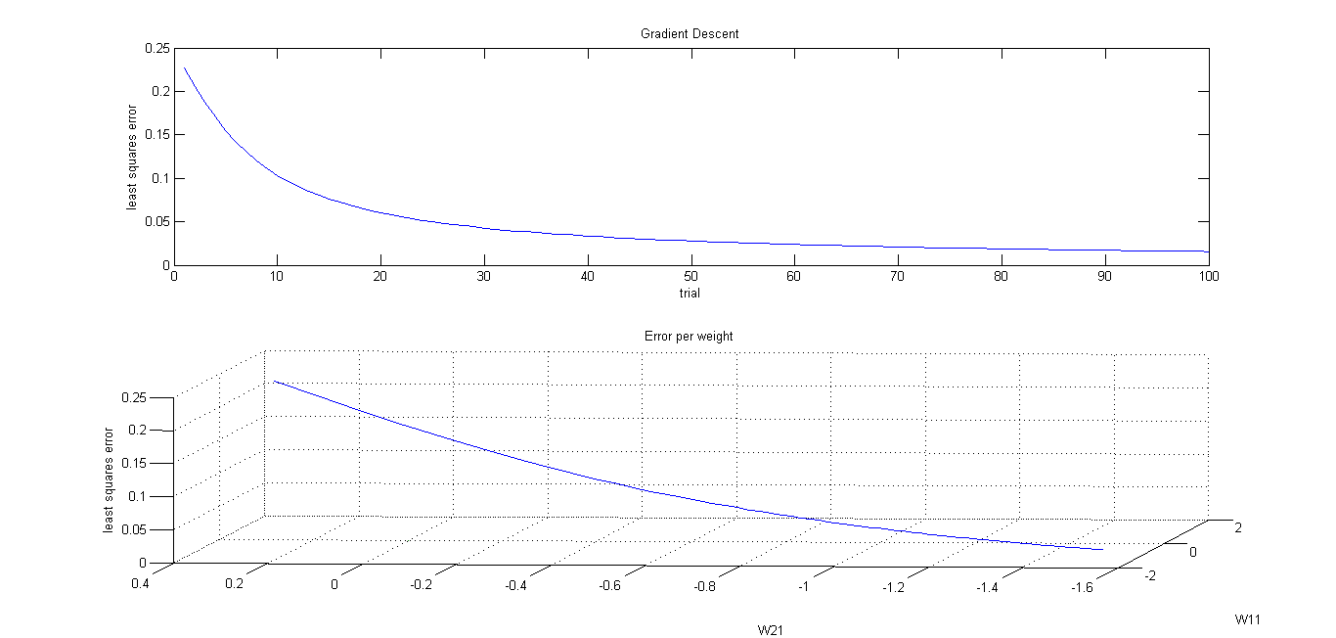

Slide 14
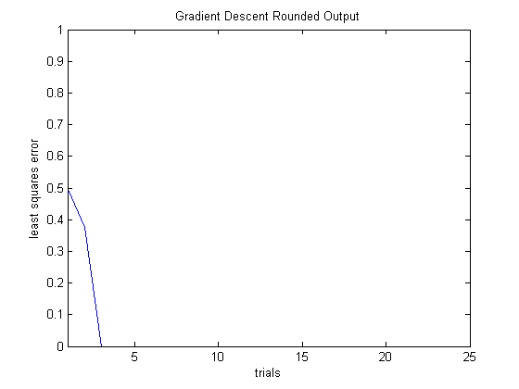

Slide 15
Neural Network next steps
Finalize Feature selection
Learning Rate selection
Seeding Function to reliably initialize the network
Pruning Method to optimize performance
Experiment with Recurrent Networks

Slide 16
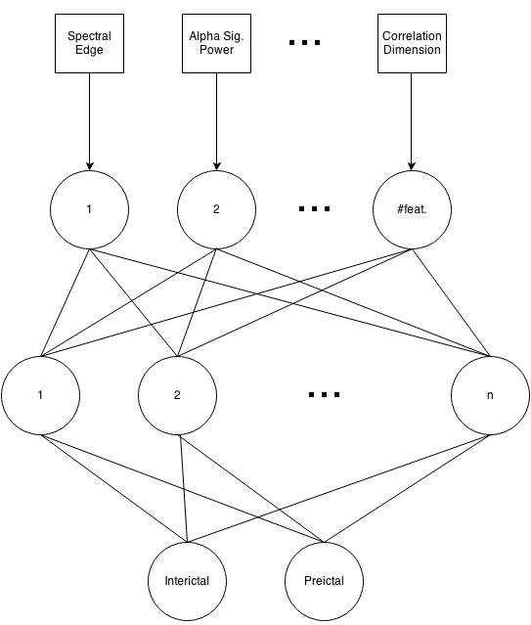

Slide 17
Judge of Quality
Sensitivity: how many preictal segments can we correctly classify?
maximize
False Positive Rate: how many interictal segments are incorrectly classified?
minimize

Slide 18
Limitations
Current features do a poor job of handling multiple channels, do not cross-correlate any channels
Initial dataset is huge
Takes ~25 minutes to load on smallest dog
Must be partitioned when generating features due to memory constraints
Storage is difficult
Seeding of neural network is basic

Slide 19
References
Maiwald, Thomas, et al. "Comparison of three nonlinear seizure prediction methods by means of the seizure prediction characteristic." Physica D: nonlinear phenomena 194.3 (2004): 357-368.
Howbert JJ, Patterson EE, Stead SM, Brinkmann B, Vasoli V, Crepeau D, Vite CH, Sturges B, Ruedebusch V, Mavoori J, Leyde K, Sheffield WD, Litt B, Worrell GA (2014) Forecasting seizures in dogs with naturally occurring epilepsy. PLoS One 9(1):e81920.

